Slide 1
How to Download tweets with Search API
Wei-Ting Liao

Slide 2
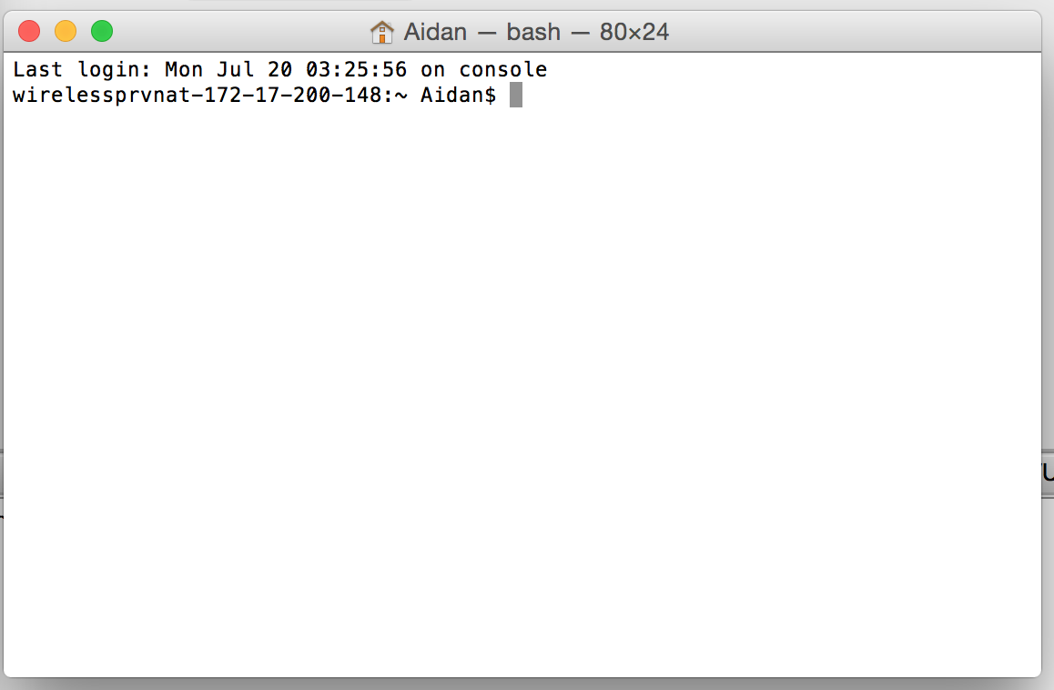
For MAC user – prepare environment
Run Applications/Utilities/Terminal

Slide 3
For MAC user – install Python packages
In Terminal:
Python is pre-installed with OSX. We only need to download the packages used in our program.
Type: sudo easy_install pip
pip is a package installation tool for Python
Type: pip install tweepy (Twitter API accessing)
Type: pip install pandas (Data analysis)
Type: pip install nltk (Natural Language Toolkit)

Slide 4
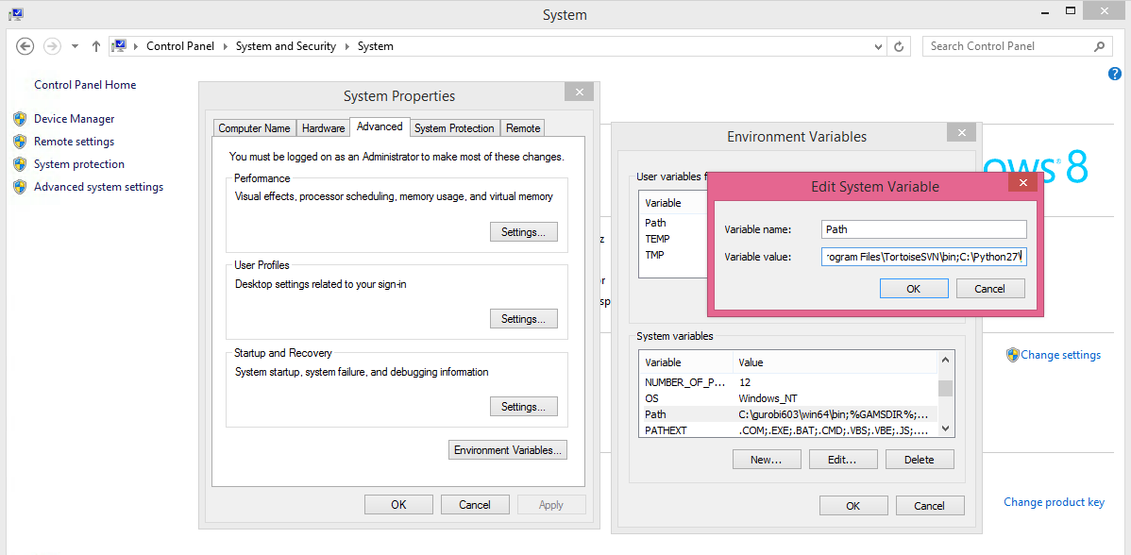
For Windows User - prepare environment
Download Python 2.7.x from: https://www.python.org/downloads/windows/
Run msi file and Install Python
Edit system variable path by adding variable value (type ;C:\Python27\)
<- Type here

Slide 5
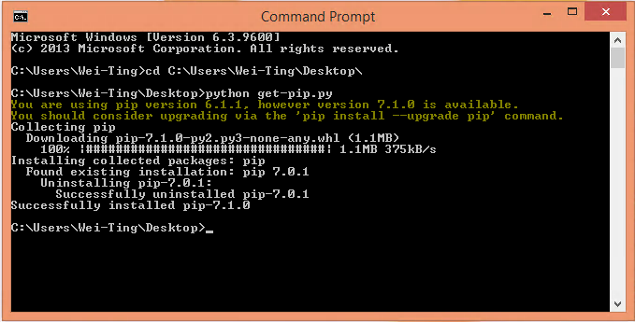
For Windows User – install pip
Open command Prompt (you can search cmd)
We need to install pip (package installation tool) first

Slide 6
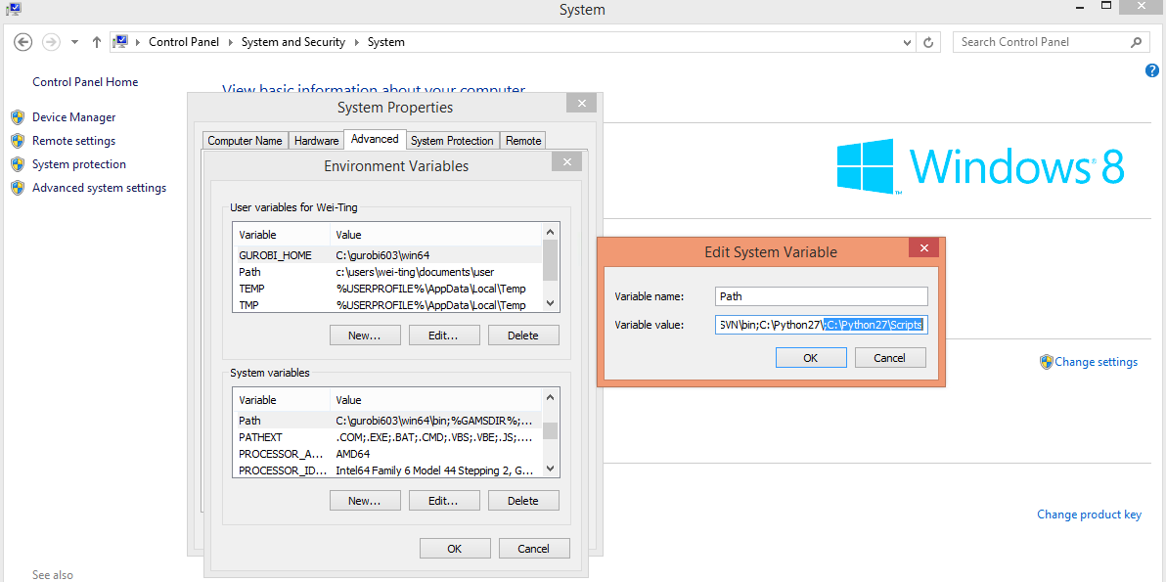
For Windows User – install pip
Edit system variable path by adding variable value for pip (type ;C:\Python27\Scripts)
<- Type here

Slide 7
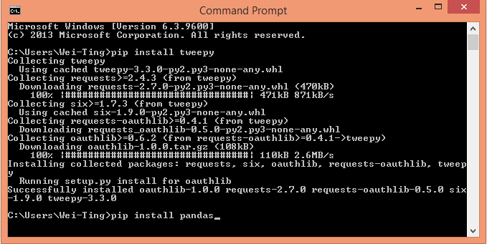
For Windows user – install Python packages
Re-open command prompt and install packages tweepy, nltk and pandas:

Slide 8
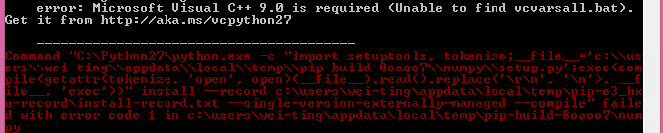
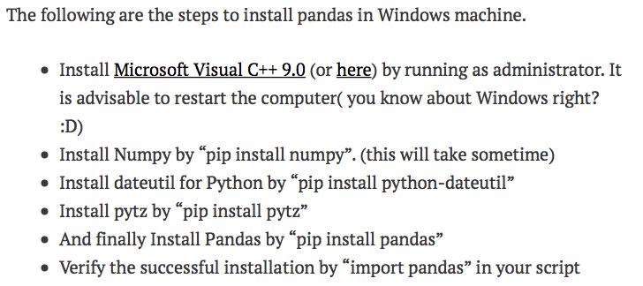
For Windows user – install Python packages
If you get an error like this while install pandas…
Try this (solution from http://venkateshtv.com/?p=58):
Visual C++ 9.0
http://www.microsoft.com/en-us/download/confirmation.aspx?id=44266

Slide 9
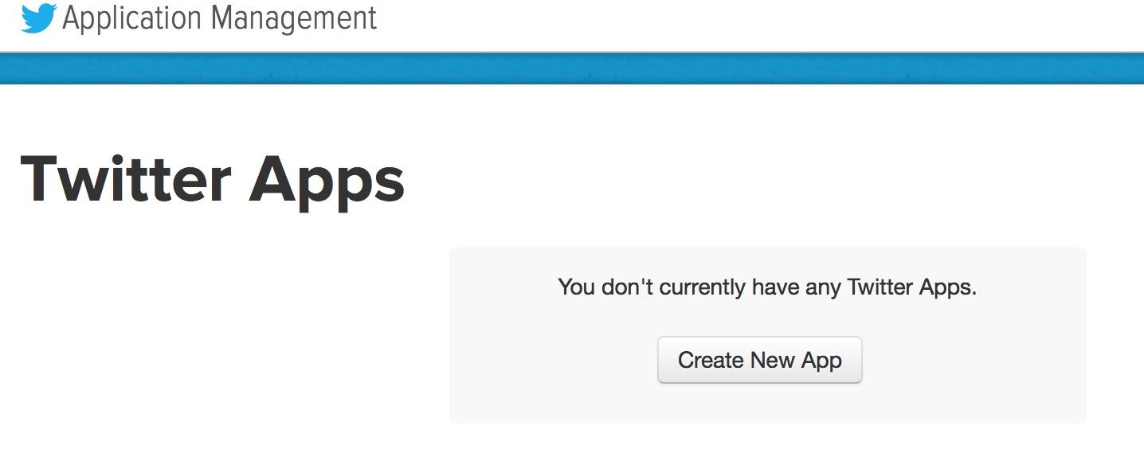
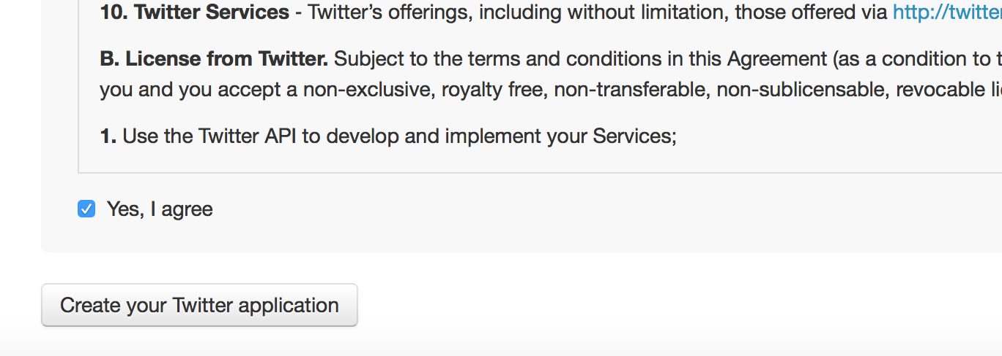
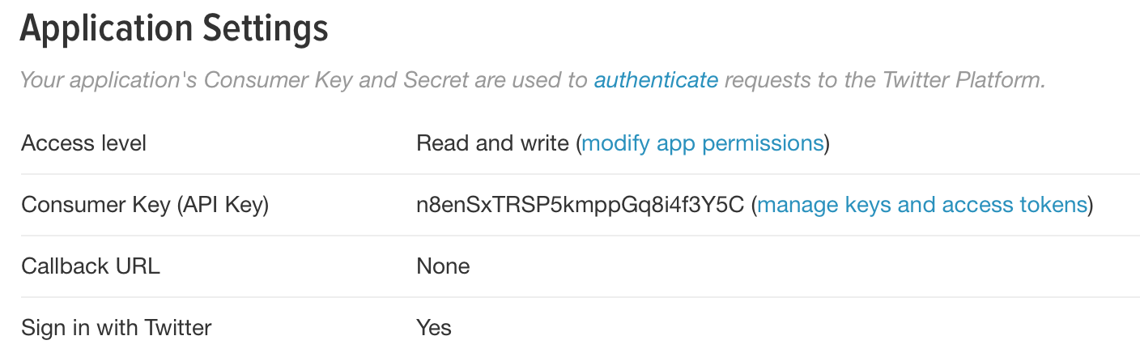
Obtain access tokens for your application
Go to
https://apps.twitter.com
Create a Twitter application
Get your key and token by click (manage keys and access tokens) or (Create my access token)
Notes:
Generating a token: https://dev.twitter.com/oauth/overview/application-owner-access-tokens

Slide 10

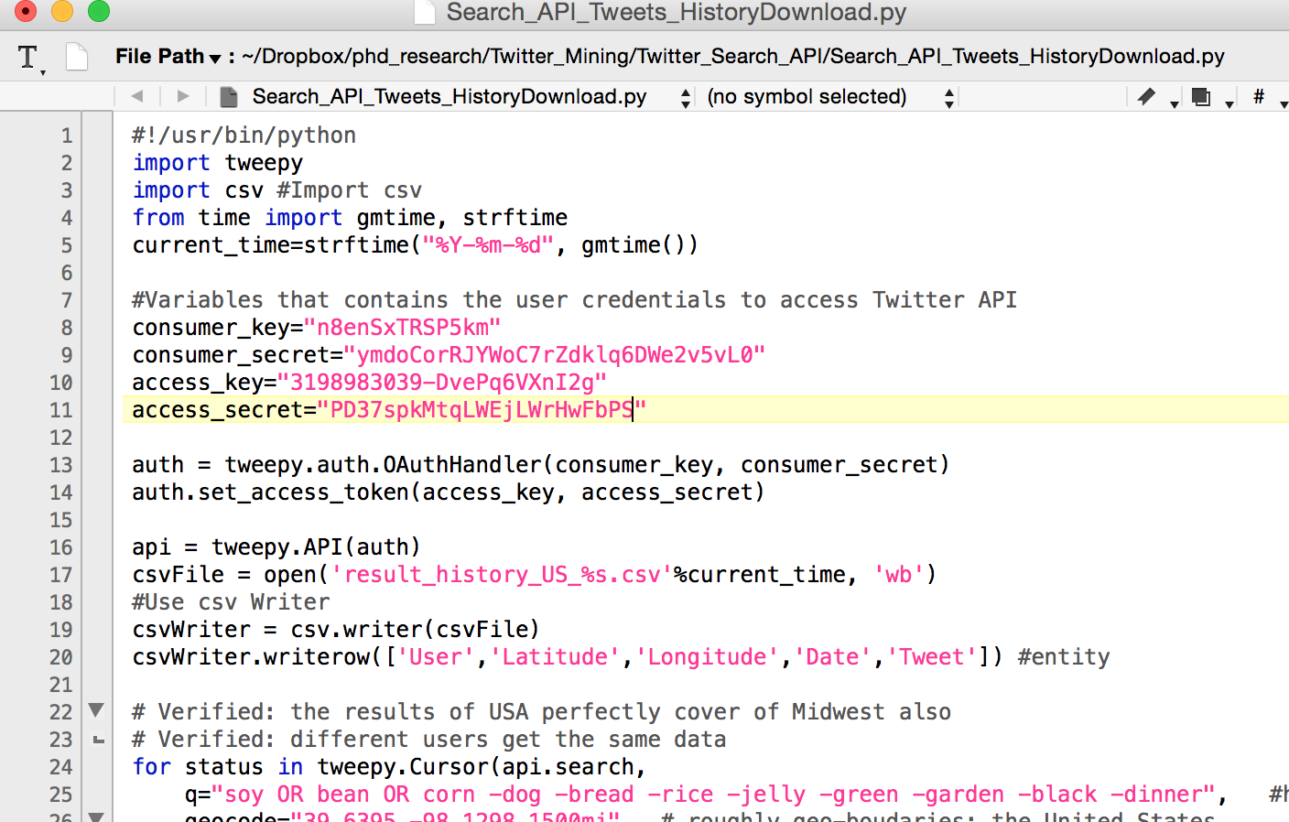
Using a text editor to open the file
Open Python Script file
You can use text editor in MAC or PC, or …
Download TextWrangler from App store for free
Download Notepad ++ from https://notepad-plus-plus.org/download/v6.7.9.2.html

Slide 11
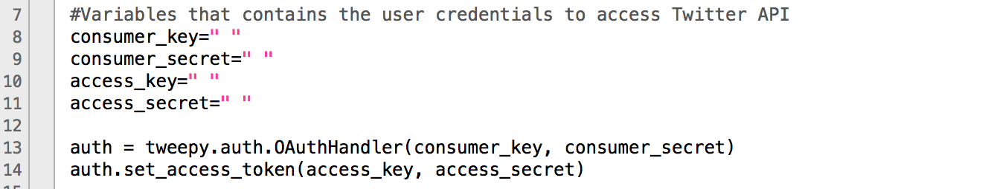
Use your own keys and tokens
In the file “Search_API_Tweets_Downloader.py”
Insert your own keys and tokens in “ ” (copy and paste from Twitter Application)

Slide 12
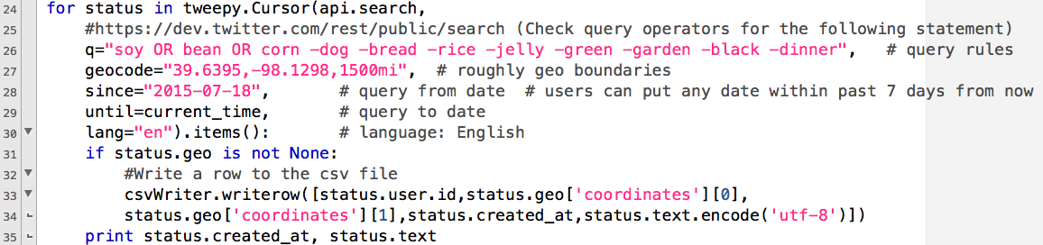
Change parameters
Check query operators: https://dev.twitter.com/rest/public/search
Change query keywords here for different topics
Starting date in past 7 days
Geo-boundaries for tweets
(Latitude, Longitude, search radius)
Remember to save the file

Slide 13
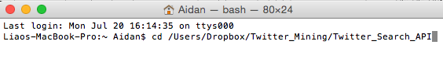
For MAC user - running the program
In Terminal
Go to the folder where you put the python script
Run the python script (Search_API_Tweets_Downloader.py) and generate results in csv file

Slide 14
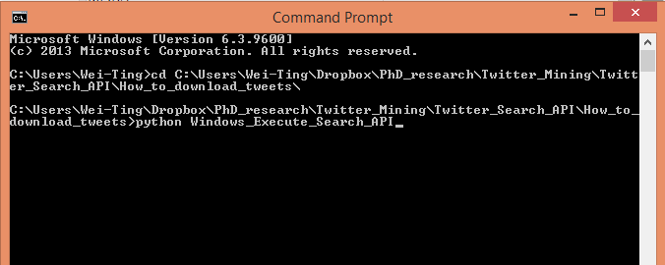
For Windows user - running the program
In Command Prompt
Go to the folder where you put the python script
Run the python script (Windows_Execute_Search_API.py) and generate results (csv file)

